Slide 1
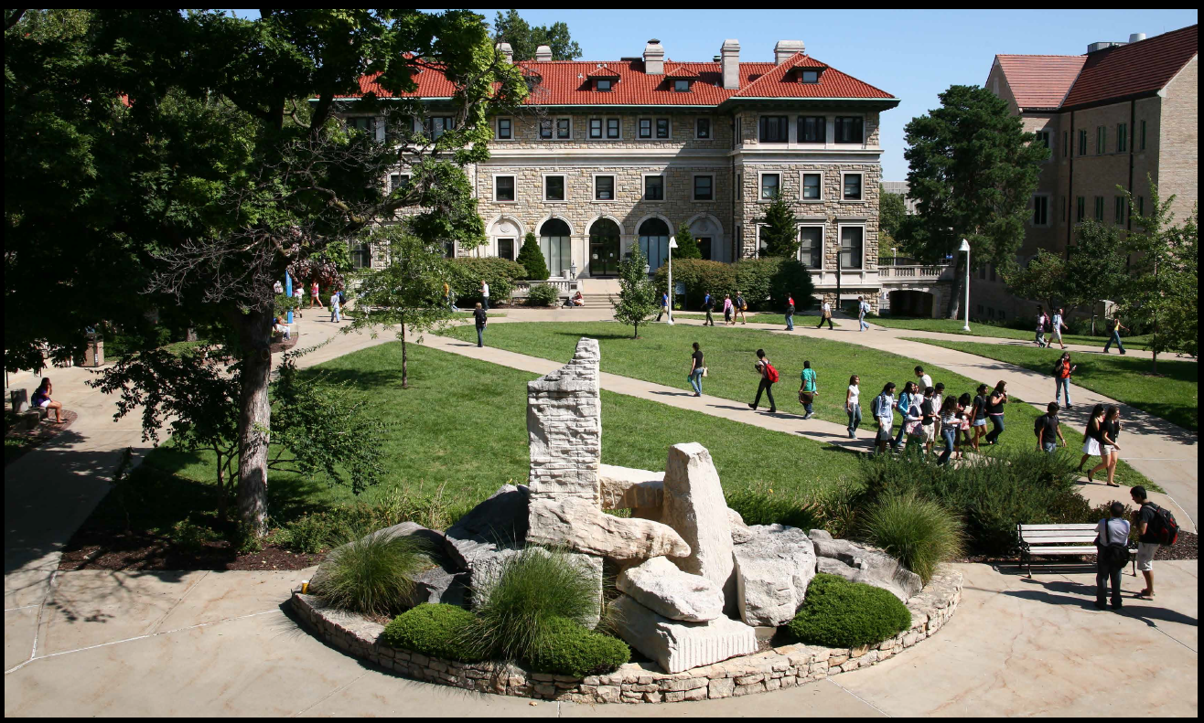
Strategic Growth Plan
University of Missouri-Kansas City
September 9, 2015
Notes:
I’m looking over all of the material for the curators off-site. I thought I would go ahead and start putting down some ideas about day two when you and I have to present about UMKC.
It appears that I need to go first to talk about the five-year vision and key goals for the campus. A primary goal of ours that they are all aware of is our objective to get enrollment to 20,000 by 2020. I think I should explain why 20,000 by 2020, including the benefits to the university in reaching that number and identifying the assets we have that make the goal make sense.
First – the need for growth:
To meet the needs of the region we serve - Essential to achieve mission and vision
To create a healthy reserve balance - critical to developing a bankable balance sheet
To support competitive compensation and faculty and staff development
To support investment in research
Why 20,000?
Balance large graduate and professional enrollment - greater than 5000
Target 75% to 80% undergraduate enrollment (typical – profitable) - 60% in 2008
Campus capacity for 20,000 is underutilized
Assets to support growth:
13 to 1 student to faculty ratio
Over 50% of classes with 20 students or less
Regional employment demand – aligned with major university degree offerings
Significant community and philanthropic support
Undervalued regional asset – significant marketing opportunity
Key initiatives:
OneUMKC – Campus-wide focus on 20K by 2020 – achieve forecast developed by SAEM
Achieve retention, graduation and placement targets – expand online courses and utilization
Professional school pricing to market – differential tuition for SCE, BSM, Conservatory
Increase philanthropy – faculty chairs, scholarships, programs, major projects, etc.
All of the above initiatives will improve quality by increasing the funding available to hire selectively and support research. Additional funding from additional students paying tuition and fees and philanthropy will minimize tuition and fee increases and increase support for scholarships – a major impact for attracting, retaining and graduating our students. Given that 80% of our cost is in compensation and benefits, our low student to faculty ratio will allow efficient growth in undergraduate enrollment.
The plan will increase our cost for faculty, scholarships and marketing. Online course development and research support (start-up funds aside from faculty compensation) is unknown but not expected to be significant in this case.
Pro forma development:
Look back at the past five years net tuition growth and project the next five years using the data from SAEM - assuming improved performance from our OneUMKC effort
Assume that we will double funded research with the attendant F&A
Look back at the past five year’s growth in philanthropy and assume continued growth rate
Look back at past five year’s compensation and benefit cost and project from 2015 results at 2% to 3% growth per year
What can we assume about the benefits from shared services?
We need to get input from Lawrence about the need to invest in research. Between us, while investing in research will satisfy to the system and others, it doesn’t move the needle for UMKC. Research does not pay for itself. It improves reputation and, theoretically, our ability to recruit top faculty but that has not proven to be a problem thus far. Increasing research will not, in the near-term, enhance our enrollment growth objectives.

Slide 2
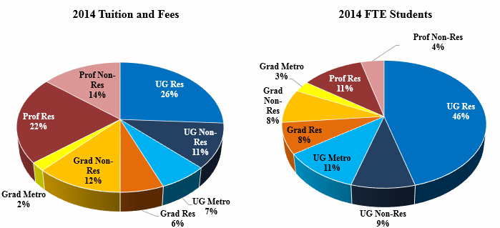
What Makes UMKC Different? UMKC-5
34% of student FTEs generate 56% of tuition and fees (graduate and professional)
Increase UG enrollment to 75%-80% to support mission and research
UG demographic requires heavy investment

Slide 3
UMKC vs. Narrowed Peer Set
 | Professional Schools
University | Dental | Medical | Pharmacy | Law | Conservatory
Cleveland State |  |  |  | X
East Tennessee State |  | X | X
U. of Akron |  |  |  | X | X
U. of Arkansas-Little Rock |  |  |  | X
U. of Memphis |  |  |  | X
U. of Nevada-Reno |  | X
U. of South Alabama |  | X | X
U. of Toledo | X | X | X | X
U. of Wisconsin-Milwaukee |  |  |  |  | X
Wright State |  | X
UMKC | X | X | X | X | X
UMKC 34% graduate/professional vs. 20.9% for peers

Slide 4
UMKC’s Unique Potential
Comprehensive University
Extraordinary Community Support
Four professional schools
Conservatory of Music and Dance
Growing schools of Engineering and Management
Arts and Sciences; Schools of Education, Biological Sciences and Nursing
Diverse and growing businesses
Chambers Big 5 Ideas – all involve UMKC
Realization – KC needs a top tier University
Unique partners – e.g. Kauffman Foundation
Philanthropy – highest per capita/KC-centric
Capacity to Grow
Other Assets
Low student-to-faculty ratio
Highly regarded faculty
Small class sizes
Enhanced facilities
Research and service
Locations
No significant local competitors
Leadership engagement – can open any door
Increase UG enrollment to achieve 20,000 total enrollment by 2020

Slide 5
UMKC Strategy Aligns With Projected Demand
2014 Brookings Institution Report
Kansas City, Missouri
Projected Employment Growth for Key Industries, 2014-2023
Industry | 2014 Jobs | 2023 Jobs | Job Growth or Loss | Percent Change
Arts | 20,424 | 22,825 | +2,401 | 11.8%
Architect, Design & Engineering | 15,880 | 18,990 | +3,110 | 19.6%
Finance & Insurance | 30,315 | 33,749 | +3,434 | 11.3%
Health Sciences & Services | 42,749 | 49,650 | +6,901 | 16.1%
Information Technology | 17,602 | 18,730 | +1,128 | 6.4%
Specialized Manufacturing | 10,665 | 10,618 | -47 | -0.4%
Nonprofit Management | 4,935 | 4,999 | +64 | 1.3%
Supply Chain Management | 13,373 | 13,400 | +27 | 0.2%

Slide 6
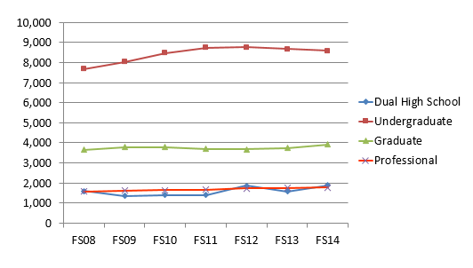
Student Enrollment Growth Fall Semesters (2008-2014)

Slide 7
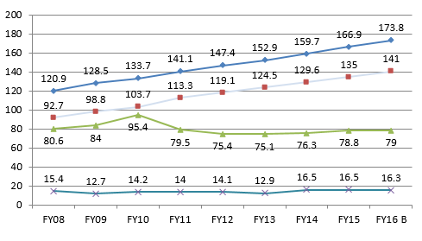
Operating Fund Revenues
Gross Tuition & Fees
(44% growth)
Net Tuition & Fees
(52% growth)
State Appropriations
Other Revenues
State appropriations include strategic funding

Slide 8
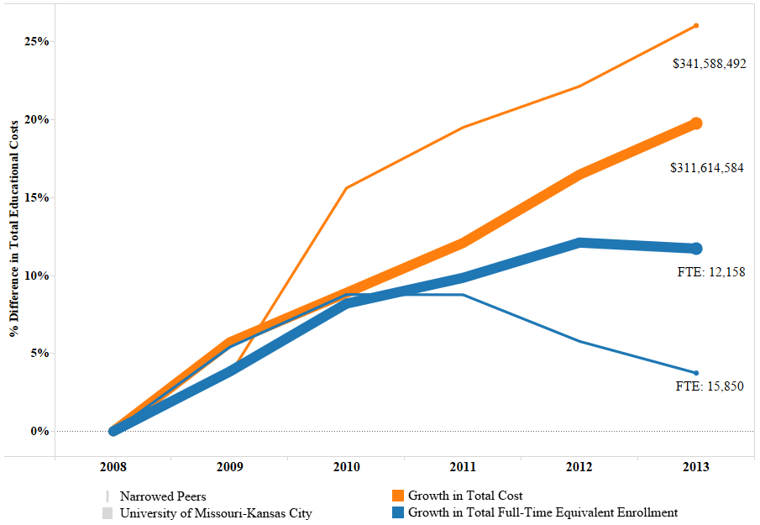
Investing to Support UG Growth UMKC-8
Investments in facilities, student services and faculty driving cost increases
Though currently falling short of UG goal, UMKC is gaining share in a declining market
UMKC enrollment grew 3.3% from 2011-2014 even as the pool of Missouri high school graduates declined 5.5% and as enrollment dropped 12% at the largest feeder community colleges

Slide 9
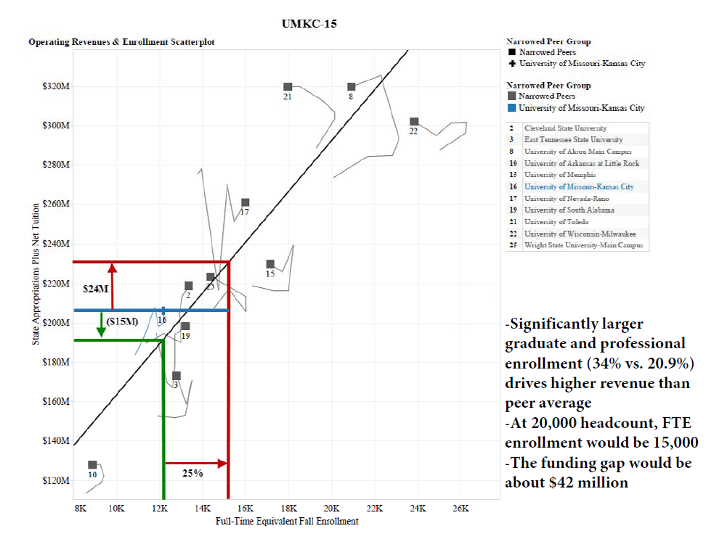
Operating Revenue Funding Gap UMKC-15
Significantly larger graduate and professional enrollment (34% vs 20.9%) drives higher revenue than peer average
At 20,000 headcount, FTE enrollment would be 15,000
The funding gap would be about $42 million

Slide 10
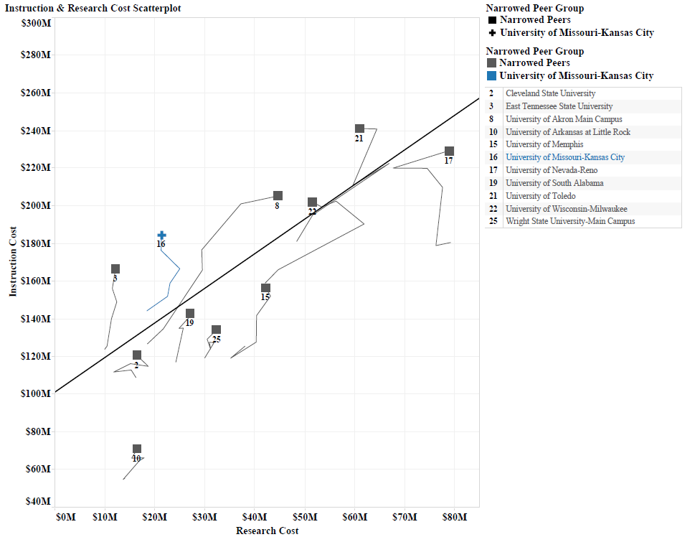
Instruction and Research Cost UMKC-14
Lost NIH-funded faculty from Health Professional schools as well as School of Biological Sciences and College of Arts & Sciences.
Future growth: Bioinformatics, Personalized Medicine, Health Outcomes, Material Science and Defense Threat Reduction Strategies.
Target: $40 million in research by 2020

Slide 11
Tuition and Fee Strategies
Unit | Standard UG Tuition | Special Fees | Differential Tuition and Fees | Market pricing
Arts & Sciences | X
Education | X
Biological Sciences | X
Nursing | X |  | X (grad only) X
Management | X |  | X
Computing & Engineering | X |  | X
Conservatory | X | X | X
Medicine |  |  | X | X
Pharmacy |  |  | X | X
Dentistry |  |  | X | X
Law |  |  | X | X
X: Current
X: Future
One size doesn’t fit all
Consulting agreement with UMSL

Slide 12
Operating Fund Reserves
Millions
Target Reserves: $90 million
Reserves – All Funds: $87.7 million
Total Endowments: $284 million FY2014
Capital Campaign: $270 million (exceeding goal)
2015 Performance
Modest revenue growth
Efficient hiring practices
Change in net assets $7.6 million
Campus received $11.4 m in FY2010 for Caring for Missourians. Balances have been adjusted to exclude that one-time funding and corresponding expenses in subsequent years.

Slide 13
Strategy for the Future
High quality/efficient enrollment growth to 20,000 by 2020
Optimize tuition and fee structure and scholarships
Strategic investment in research and faculty/staff development
Increased regional collaboration to increase student experiential learning
Cost efficiencies/space utilization/shared services

