Slide 1
Death by a Thousand Cuts
Presentation to Faculty Senate 10-21-14

Slide 2
Lost benefits, rights and privileges
Academic Freedom and Development (TT faculty replaced by NTT)
Pension plan changes (from defined benefit to defined contribution)
Increased pension contributions
Increased health plan costs
Long-term care option
Reduced compensation for summer teaching
Faculty Research Grants
Fewer TAs and graduate fellowships (graders for Gen Ed courses)
Diminished graduate programs
Diminished start-up funds
Office/work space/labs
Travel funds
Physical library books
No food for activities
No budget for enrichment, recruitment
Printers
Licenses for survey/research tools, software and data-bases
Server space

Slide 3
Additional Duties
Advising
Assessment
Recruitment
Curriculum Committees (more of them)
Departmental duties (fewer TTs to share departmental service)
Increased grading loads (loss of GTAs and graders)
Book-keeping responsibilities (purchasing, travel)
Increased frequency of training modules.
Some cleaning services lost due to outsourcing
Curriculum Navigator/software

Slide 4
Partial Bibliography Critical Research on Higher Education
Anstine, Jeff. “Graduation Rates at U.S. Colleges and Universities: A Large Data Set Analysis.” Business Education and Accreditation, Vol 5 (2), 2013, pp. 55-64.
Armstrong, E. and Hamilton, L. Paying for the Party. Harvard University Press, 2013.
Bowen, William, et al. Crossing the Finish Line. Princeton University Press, 2009.
Cross, J. and Goldenberg, E. Off-Track Profs: Non-Tenured Teachers in Higher Education. MIT Press, 2009.
Damast, Alison, “The Out-of-State Solution to College Budgets.” Businessweek, 9/8/2011.
Ginsberg, B. The Fall of the Faculty: The Rise of the All-Administrative University and Why it Matters. Oxford University Press, 2013.
Giroux, H. Neoliberalism’s War on Higher Education. Haymarket Books, 2014.
Harrington, C. and Schibik, T. “Caveat Emptor: Is there a Relationship Between Part-Time Faculty Utilization and Student Learning Retention?” Association for Institutional Research Professional File, Vol 91, 2014.
Kezar, A., Maxey, D., Badke, L. “The Imperative for Change.” The Delphi Project on the Changing Faculty and Student, 2013.
Kezar, A. and Gehrke, S. “Why Are We Hiring so Many Non-Tenure-Track Faculty?” Association of American Colleges and Universities, Vol. 100 (1), 2014.
Marcus, Jon. “New Analysis Shows Problematic Boom in Higher Ed Administrators.” New England Center for Investigative Reporting, 2/6/2014.
Schibik, T. and Harrington, C. “The Outsourcing of Classroom Instruction in Higher Education.” Journal of Higher Education Policy and Management, Vol. 26 (3), 2004, pp. 393-400.
Smith, Curtis. “The Impact of Part-Time Faculty on Student Retention: A Case Study in Higher Education.” Doctoral Dissertation, Univ. of Missouri, Kansas City, 2010.
Wang, Marian. “Country Club Campuses.” Propublica 11/11/2013.

Slide 5
National Research Highlights
As of 2009 only 44 % of entering students were graduating college (Bowen 2009).
Dominant variables determining graduation rates: classroom size, faculty salaries, and workplace conditions (Anstine 2013).
By 2005 there was a 48% increase in the percentage of part-timers at Universities nationwide (National Center for Educational Statistics)
By 2009, non-tenured faculty accounted for “approximately 70 percent of the faculty providing instruction at nonprofit institutions nationwide” (Assoc. of the Governing Boards of Univ. and Colleges, May/June 2013).
By expanding the number of NTT (non-tenured) positions the faculty to student ratio has remained fairly stable since 1975 (16 %). But, the number of students for every administrator or staffer has gone down—from 1 for every 84 in 1975 to 1 for every 58 in 2005 (National Ctr for Ed Stats).
“In all, from 1987 until 2011-12…universities and colleges collectively added 517,636 administrators and professional employees, or an average of 87 every working day” (Marcus 2014).

Slide 6
CAS Department Survey: 18 total—16 responded
Part One
Net Loss of FT and FTE Faculty (not replaced) in the past 3 years: 31
Psychology 4
Geosciences 2
Economics 2
CJC 0
AUPD 0
Sociology 3
Social Work 3
Theater 2
History 4.5 (FTE)
Comm Studies 1
Math 3
Philosophy 3
Foreign Lang 0
Physics 0
Art 0
English 4 (NTT)
Chemistry ?
Political Science ?

Slide 7
Do you have adequate resources? Is faculty morale low?
Psychology: less funding for doctoral students causing financial stress. Low morale? “Yes.”
Geosciences: “We are near the breaking point.” Low morale? “Absolutely.”
Economics: Faculty are teaching overloads. Low morale? “Absolutely.”
CJC: “Barely” making due; faculty getting accustomed to “making due with less”
AUPD: “We are on an unsustainable level of demands.” Low morale? “Yes.”
Sociology: Unable to meet demands. Low morale? “Yes.”
Social Work: “Its getting harder to keep Dept. in the black. E&E is killing us” Low morale? “Of course.”
Theater: “we are being forced to shrink our MFA program.” Low morale? “ABSOLUTELY!”
History: “ScH #’s are in decline because of the loss of faculty.” Lost two programs (Am Studies and Rel Studies). Low morale? “I don’t think any faculty…is happy....”
Comm Studies: “We need more faculty.” Low morale? “Very much so.”
Math: “We are desperately in need of more math faculty.” Low morale? “It appears to be.”
Foreign Lang: Need a new Spanish hire to accommodate growth. Low morale? Yes.
Physics: Quality has declined in order to meet current demands. “Yes, faculty morale has suffered substantially. It is much harder to mobilize faculty to volunteer. Initiatives are received with resentment.”

Slide 8
Salary Levels
Except for CJC and Art, all departments that looked at the national averages of comparator institutions and programs report below average salaries to varying degrees.
From one Dept. Chair:
“Administrative salaries are too high in relation to faculty compensation. The administrative positions tend to turn over and with each new administrative hire the salary increases. The argument that we hear is that they are within the national norm. That national norm seems not to apply to faculty and staff salaries. Titles have exploded…and appears to be the method used to promote and compensate administrative staff at a higher rate than the rest of the university. Need to remember—these people DO NOT GENERATE INCOME. The shifting of titles and responsibilities has been a game of hiding salary increases in the administrative ranks. No accountability of the administration to the College or the departments. Even though they are here to support us.

Slide 9
Work Loads
Class-size increase? Yes. Some Depts. report increases in some classes, but not all. Full exception (experiencing declining enrollment) is History while class size is steady for Theater and Social Work.
Teaching loads? NTT loads are creeping up. Individual faculty are absorbing overloads. More invisible forms of overload like independent work and internships going up. AUPD has always absorbed an overload. History anticipates an increase. CJC is steady; tenure-track faculty in Soc are steady; Theater and Social Work are steady.
Have faculty taken on additional tasks? Yes, with the exception of CJC and Social Work. Physics and History did not answer the question. Some Depts. specified tasks-- recruitment, advising, and assessment.

Slide 10
Part Two (Anonymous) Administrative support from Oak Street?
“unfavorable…decisions…result in inefficient use of the resources.”
“No, not at all: on the contrary.”
“It is unclear how ‘Oak Street Administration’ aids the department’s needs in any direct or significant way.”
“No. All I have ever heard from the Administration is that faculty spend too much time complaining and asking for resources.”
“The burdensome hoops they’ve imposed that we have to jump through to do EVERYTHING nowadays makes productivity plummet…”
“RESOUNDING NO.”
“Absolutely not.”
“…there is no direct support of the department…”
“Oak St Administrators seem very far removed from ‘boots on the ground’ realities of faculty.”
“No.”
“It’s a mix. I find some of the support groups in Student Affairs actually make my job more difficult....”
“Perhaps.”

Slide 11
Budget Model/Misallocation of Resources?
“I get the impression that the College has been given the short end of the stick…”
“This budget model has promoted a ‘multiversity’ rather than a ‘university’….There is a severe misallocation of resources…”
“I have no way to tell…”
“Yes.”
“The model definitely improperly distributes financial resources between the schools.”
“Yes, most definitely!”
“…benefits initially purported by the budget model have not come to fruition in my department or college.”
“Absolutely. It has turned the College of A&S into a fiscal mess…”
“Yes.”
“Yes—The budget model pits schools and colleges against one another.”
“Absolutely. The Budget Model is a passive-aggressive mechanism to re-allocate funding into Health Sciences at the expense of the College….The College is being turned into a service unit.”
“Very much so.”

Slide 12
Adequate staffing and administrative support?
“Absolutely Not”
“No—The breadth of what faculty are expected to do has exploded exponentially. Recruitment and development…falls on the faculty. No one else is doing this work. Not an efficient use of faculty time—expensive in fact!”
“Almost.”
“No. We are…woefully understaffed.”
“…current staffing levels do not support growth.”
“…we are very concerned with the talk of ‘sharing staff’ at UMKC, which would be disastrous if implemented for us.”
“No.”
“No…our request for a replacement AA…was denied….”

Slide 13
UMKC Data from the US Dept. of Education, Integrated Postsecondary Education Data System (IPEDS)
http://nces.ed.gov/ipeds/
http://highereddata.aft.org/

Slide 15
Instruction
“Expenditures of the colleges, schools, departments, and other instructional divisions of the institution and expenditures for departmental research and public service that are not separately budgeted are included in this classification. Also included are expenditures for both credit and noncredit activities. Expenditures for academic administration where the primary function is administration (e.g., academic deans) are excluded. The instruction category includes general academic instruction, occupational and vocational instruction, special session instruction, community education, preparatory and adult basic education, and remedial and tutorial instruction conducted by the teaching faculty for the institution's students.”
Source: Source: Higher Education Data Center, highereddata.aft.org

Slide 16
Research
“This category includes all funds expended for activities specifically organized to produce research outcomes and commissioned by an agency either external to the institution or separately budgeted by an organizational unit within the institution. Non-research sponsored programs are not reported.”
Source: Source: Higher Education Data Center, highereddata.aft.org

Slide 17
Public Service
“Funds budgeted specifically for public service and expended for activities established primarily to provide noninstructional services beneficial to groups external to the institution are reported. Examples are seminars and projects provided to particular sectors of the community. Include expenditures for community services and cooperative extension services.”
Source: Source: Higher Education Data Center, highereddata.aft.org

Slide 18
Academic Support
“This category includes expenditures for the support services that are an integral part of the institution's primary mission of instruction, research, or public service. Expenditures for libraries, museums, galleries, audio/visual services, academic computing support, ancillary support, academic administration, personnel development, and course and curriculum development are included. Expenditures for veterinary and dental clinics if their primary purpose is to support the institutional program are included.”
Source: Source: Higher Education Data Center, highereddata.aft.org

Slide 19
Student Services
“Funds expended for admissions, registrar activities, and activities whose primary purpose is to contribute to students' emotional and physical well-being and to their intellectual, cultural, and social development outside the context of the formal instructional program. Examples are career guidance, counseling, financial aid administration, and student health services (except when operated as a self-supporting auxiliary enterprise). The administrative allowance for Pell Grants is included.”
Source: Source: Higher Education Data Center, highereddata.aft.org

Slide 20
Institutional Support
“Expenditures for the day-to-day operational support of the institution, excluding expenditures for physical plant operations. Expenditures for general administrative services, executive direction and planning, legal and fiscal operations, and public relations/development are included.”
Source: Source: Higher Education Data Center, highereddata.aft.org

Slide 21
Operation & Maintenance of Plant
“Expenditures for operations established to provide service and maintenance related to grounds and facilities used for educational and general purposes. Also included are expenditures for utilities, fire protection, property insurance, and similar items. Expenditures made from the institutional plant funds account are not included.”
Source: Source: Higher Education Data Center, highereddata.aft.org

Slide 27
Executive, Administrative, Managerial
“A primary function or occupational activity category used to classify persons whose assignments require management of the institution, or a customarily recognized department or subdivision thereof. . . . Included in this category are employees holding titles such as: top executives; chief executives; general and operations managers; advertising, marketing, promotions, public relations, and sales managers; operations specialties managers; administrative services managers; computer and information systems managers; financial managers; human resources managers; purchasing managers; postsecondary education administrators such as: presidents, vice presidents (including assistants and associates), deans (including assistants and associates) if their principal activity is administrative and not primarily instruction, research or public service, directors (including assistants and associates), department heads (including assistants and associates) if their principal activity is administrative and not primarily instruction, research or public service, assistant and associate managers (including first-line managers of service, production and sales workers who spend more than 80 percent of their time performing supervisory activities); engineering managers; food service managers; lodging managers; and medical and health services managers.”
Source: Source: National Center for Education Statistics, Glossary, http://nces.ed.gov/ipeds/glossary/

Slide 29
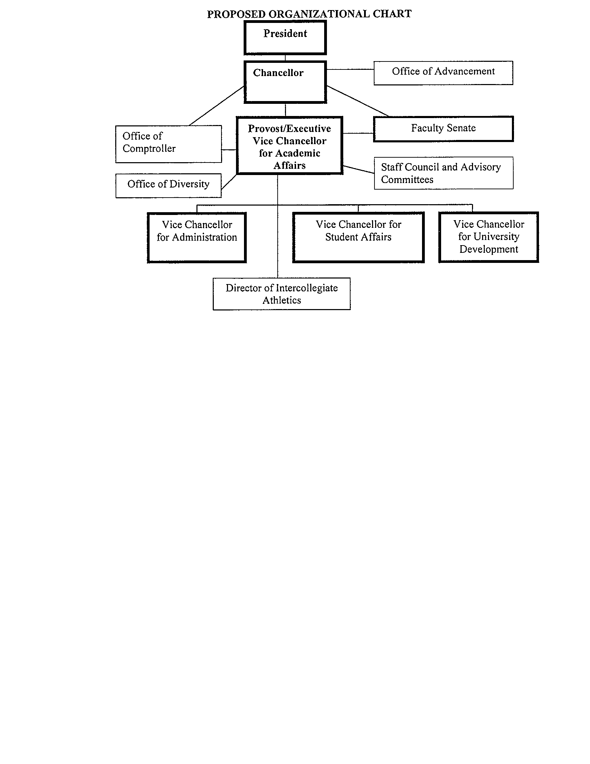
COSCO (2005) Recommendation: 4 Vice Chancellors

Slide 30
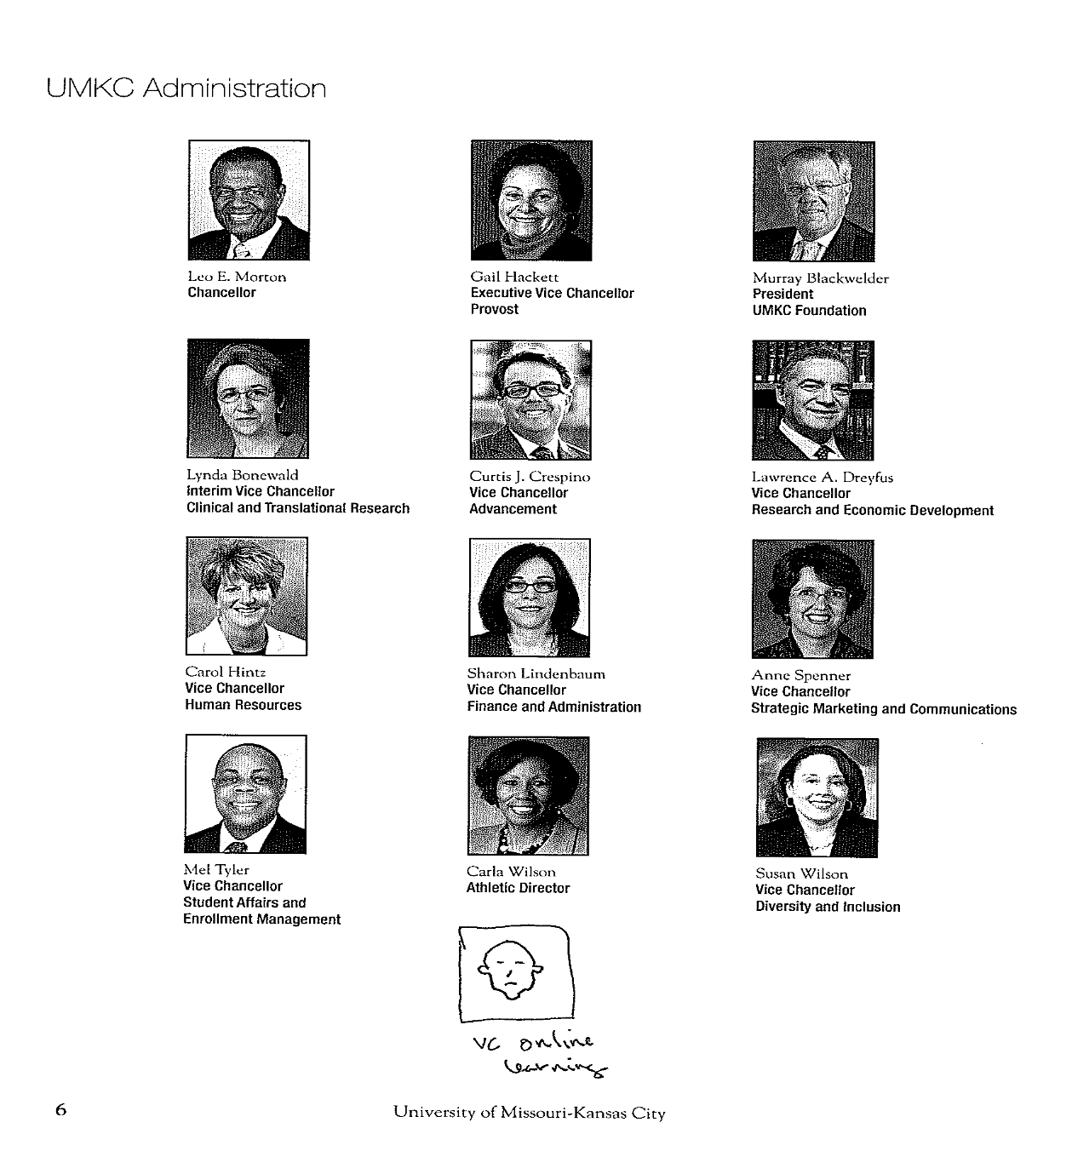
2014 Vice Chancellors: 11

