Slide 1

Reimagining Our
University Experience
Campus Presentation

Slide 2

About the Task Force

Slide 3

Who we are…

Slide 4
What we value
Career
Benefits
Work Content
Pay
Culture

Slide 5
The issues we face
57% have pay less than $50,000
Employee Demographics
25% of Faculty Retirement Eligible
Turnover is highest in 1st year
Declining State Funding
Change in Financial Reporting
So what are we going to do about it?
Legislative/
Regulatory Changes
Don’t understand the options available to them
Benefits are more than pay and insurance
Patient Protection and Affordable Care Act (PPACA)
Employee Feedback
Pay is top for recruitment and retention

Slide 6

What makes us an excellent place to work
6

Slide 7

Task Force charge:
Balance two key areas of concern
Non-competitive pay levels
Many employees rate themselves as “unhealthy”
Liabilities over $1 billion
Unsustainable growth in benefits costs
ATTRACT AND RETAIN THE BEST PEOPLE
MANAGE COSTS EFFECTIVELY

Slide 8

Key themes for reimagining our
University experience
Efficiency/ Sustainability
Strategic
Competitiveness
Shared Responsibility
Education/
Communication
Task Force Discussions
Flexibility to Address Diverse Needs
Interplay between
Pay and
Benefits

Slide 9
Total Rewards Task Force
Directional Recommendations

Slide 10
Treat benefits and pay as interrelated parts of overall
Total Rewards strategy
Interplay between
Pay and
Benefits
Strategic
Competitiveness
RECOMMENDATION 1
!
Challenges
  Pay not competitive
  Historically considered benefits separate from pay
  Benefits costs increasing substantially despite minimal changes
  As spend more on benefits, less available for pay

Slide 11
Treat benefits and pay as
interrelated parts of overall
Total Rewards strategy
Interplay between
Pay and
Benefits
Strategic
Competitiveness
RECOMMENDATION 1
Identify new funding sources and reallocate from lower priorities to improve pay
Include all employee perceived benefits when communicating Total Rewards
Total Rewards Strategy
Update traditional practices and committees
Direct any funds reallocated from benefits
to pay

Slide 12
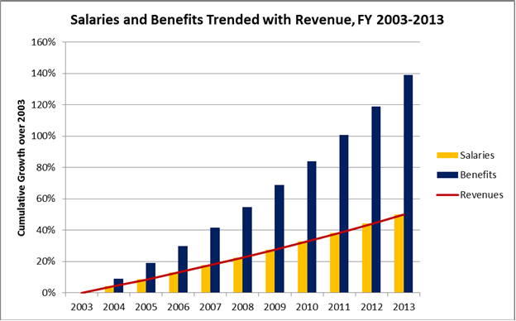
Establish a benefits rate cap
Shared
Responsibility
Efficiency/ Sustainability
RECOMMENDATION 2
Set cap as a % of pay to ensure the appropriate balance between benefits and pay
Benchmark benefit offerings, plan designs and pay on a systematic basis

Slide 13

Increase flexibility within Total
Rewards programs
Flexibility
to Address Diverse Needs
Strategic
Competitiveness
RECOMMENDATION 3
Flexibility for Individuals
Recognize our population is increasingly diverse; what is valued differs among workforce segments and life cycles
Revise “one size fits all” approach to benefits

Slide 14
Increase flexibility within Total
Rewards programs
Flexibility
to Address Diverse Needs
Strategic
Competitiveness
RECOMMENDATION 3
Flexibility for Campuses
Align Total Rewards to support campus strategic priorities for recruitment and retention
  Competitive pay
  Targeted recruitment and retention by campus
  Part-time staffing needs of MU Health Care

Slide 15
Utilize medical plan options to lower costs and encourage healthy behavior
Efficiency / Sustainability
Shared
Responsibility
RECOMMENDATION 4
!
Challenges
  Medical plan costs increasing $3 million/year
  Could grow by over $24 million by 2024
  Only 30% of employees currently participate in wellness activities

Slide 16
Utilize medical plan options to lower costs and encourage healthy behavior
Efficiency / Sustainability
Shared
Responsibility
RECOMMENDATION 4
Increased healthy behavior
Make it easier to get health care, preventive care, and support for health conditions
Provide tools to assess cost and quality
Take advantage of new medical plan concepts
Link employee health behavior to medical plan premiums
Engage line managers in creating a supportive environment for health and well-being
Embed healthy practices across the campuses
Lower medical costs

Slide 17
Leverage marketplace opportunities for retiree medical benefits
Flexibility
to Address Diverse Needs
Education/
Communication
RECOMMENDATION 5
!
Challenges
Opportunities
  $1 billion in unfunded retiree medical liability by 2018
  Generous compared to peer institutions
  Cannot be sustained
  Higher-value, lower cost medical plans available in public retiree medical insurance marketplace
  By 2020 Medicare changes will reduce need for additional retiree medical coverage

Slide 18
Leverage marketplace opportunities for retiree medical benefits
Flexibility
to Address Diverse Needs
Education/
Communication
RECOMMENDATION 5
Align practices with peers to better serve retirees
Ensure the availability of accessible and affordable retiree medical coverage
Continue to guide and support retirees with education and
personal support

Slide 19
Evaluate additional
Retirement Plan options
Shared
Responsibility
Efficiency / Sustainability
RECOMMENDATION 6
!
Challenges
  We are one of only two peer institutions to offer a pension plan
  Current unfunded liability = $500 million

Slide 20
Evaluate additional
Retirement Plan options
Shared
Responsibility
Efficiency / Sustainability
RECOMMENDATION 6
Maintain commitment to a financially viable retirement trust fund
Consider simplifying the retirement plan for future employees
Consider allowing current employees to opt out of the current plan to another plan

Slide 21
Evaluate time-off plans for Staff
Flexibility
to Address Diverse Needs
Strategic
Competitiveness
RECOMMENDATION 7
Align the leave benefits with the Total Rewards strategy and healthy campus initiatives
Simplify leave policies as much as possible
Provide short-term disability income replacement
Emphasize value and flexibility through an integrated time-off benefit program
Encourage appropriate use of time-off benefits

Slide 22

Invest in communication, education and behavior change
Shared
Responsibility
Education/
Communication
RECOMMENDATION 8
Increase employee understanding/appreciation for value of Total Rewards
Provide tools to help employees make optimal choices at times of key decisions
Tailor resources to diverse needs, learning styles and behaviors
Coach managers in communicating about pay and benefits

Slide 23
Next steps
April 14
through May 2014
Campus constituent group discussions
2015 - 2018
Further development of recommendations with faculty/staff/retiree input

Slide 24
Want to know more?
To find out more, visit
www.umsystem.edu/totalrewards/ reimagining
Send comments to
reimagining@umsystem.edu

Slide 25

Q&A

Slide 26

Presentation Feedback

