Slide 1
Faculty Senate
11.19.13

Slide 3
Goals in Product Selection
Improve Communication Between Advisors, Students, Instructors
Improve Access to Support Services, Advisors and/or Faculty
Electronic Access to Appointment Scheduling
Clear Identification of Resources for Specific Courses
Increase Advising Efficiency
Mechanism to Identify Students Needing Assistance
General Well Being, Performance Related
Off Track Enrollment
Get Out of the Way of Students Excelling
Re-enforce Course Expectations & Use of Technology
Craft an Education Plan to Graduation
Faculty Advisor Input Maximize Major and Elective Choices

Slide 4
Target Interactions Between Advisors and Students
Enrollment Advising
In-Progress Term Advising

Slide 9
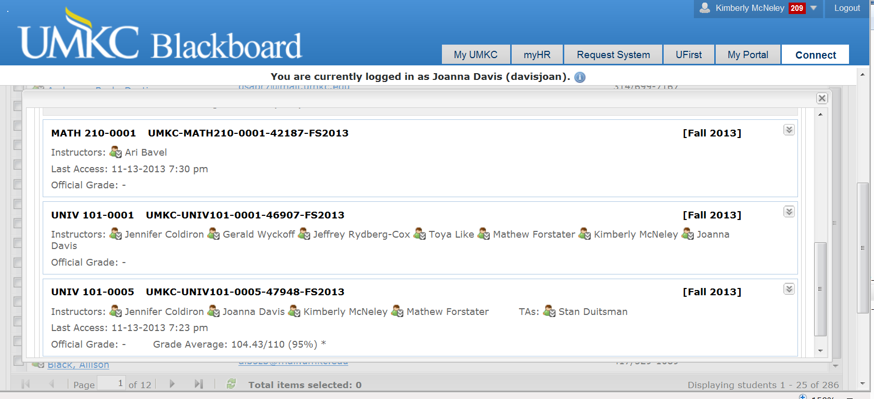

Slide 10
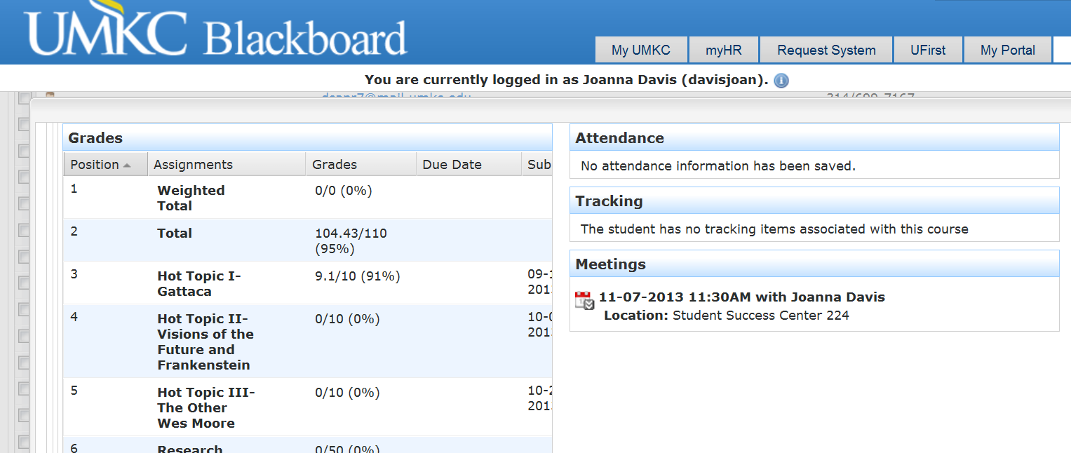

Slide 12
Goals in Product Selection
Improve Communication Between Advisors, Students, Instructors
Improve Access to Support Services, Advisors and/or Faculty
Electronic Access to Appointment Scheduling
Clear Identification of Resources for Specific Courses
Increase Advising Efficiency
Mechanism to Identify Students Needing Assistance
General Well Being, Performance Related
Off Track Enrollment
Get Out of the Way of Students Excelling
Re-enforce Course Expectations & Use of Technology
Craft an Education Plan to Graduation
Faculty Advisor Input Maximize Major and Elective Choices

Slide 13
First Steps
Advisor Access
Role Configuration to Maximize Confidentiality of Record
Based on a “Need to Know”
Training
Will be ongoing
Calendaring

Slide 14
Next Steps
Identify Further Data Access Limitations
Faculty Awareness of Advisor Expectations & System Use
Faculty Input
Early Alert Set-Up
Faculty Awareness of Options to Support Instructor/Student Communication
Blackboard Use will Increase Because of Student Support Capabilities
Starfish Connect Office Hour Appointments
Starfish Connect Alerts and Kudos

Slide 15
Starfish Demonstrations
Monday, December 2 at 2:30
Fine Arts Building, Room 307
Thursday, December 5 at 8:30
Fine Arts Building, Room 307
By Request
Call 235-8648 to set a time and location

Slide 16
Faculty Senate
Discussion regarding advisor access to Bb

