Slide 1
UMKC ATHLETICS PRESENTATION
December 2, 2011

Slide 2
Points of Discussion
Athletics History - Timeline
Forward.Together
Why Be in Division I
Case Studies
Divisional Comparison
Divisional Peers
Division I – National Competitiveness
Division I – Conference Competitiveness
Division I – Facility Success
Division I – Improved Scheduling with New Peer Group
Division I – UMKC Staffing
Division I – External Revenue Growth
Budget – Total Athletic Budget
Budget – Sports Operating Budget
Sources of Revenue – Student Fees, Institutional Support, External Support
UMKC Institutional Comparison

Slide 3
HISTORICAL PERSPECTIVE

Slide 4
Athletic History - Timeline
Intercollegiate athletics has been at UMKC for 57 years.
Program is entering its 24th year as a Division I program and 17th year in the Summit League.
Four NCAA Tournament appearances in programs first 20 years, five in the past five years.
1954
1969
1985
1987
1994
1999
2001
2005
2007
Athletics formed at UMKC
DI pursuit presented by KC Mayor
1st NCAA team invitation – men’s tennis (also 2000)
Men’s basketball 11-game win streak
First year of Division I
Soccer receives NCAA Tournament invite (also 2003)
Tim Hall hired as AD
Athletics joins NAIA
Joined the Summit League

Slide 5
Forward.Together
  The Forward.Together strategic initiative was developed in 2007 by director of athletics Tim
  Hall, to enhance and improve UMKC athletics in alignment with the institutional Mission and
  Vision.
  Key metrics of the Forward.Together plan included :
Academics –Reinforce focus for strong academics amongst our student athletes. (Place Student Success at the Center.)
Competitiveness – Improve competitiveness within the Summit League and nationally (Director’s Cup). Set goal of finishing in top-third of Summit League Commissioner’s Cup. (Place Student Success at the Center, active engagement with its city and region).
Budget – Increase overall athletic budget support, which falls $2 million below the conference average. Included in this goal will be to improve efficiencies and increase external revenue support. (Strengthen resource base and financial capacity).
Attendance – UMKC will increase attendance in both men and women’s basketball. (Strengthen resource base and financial capacity; active engagement with its city and region).
Staffing – Improve administrative and coaching staffing levels, which fall in the bottom-third of the Summit League. (Place Student Success at the Center, Embrace Diversity).
Facilities – UMKC athletics facilities lag behind the Summit League. Follow-through on initiatives to provide a world-class experience for our student-athletes and to be competitive at the Division I level (Active engagement with its city and region).

Slide 6
DIVISION I

Slide 7
Why Division I
Alignment with institutional peers - 19 of Urban 21 are Division I programs.
“Alignment through competition” (i.e. KU, Mizzou, Kansas State)
Align highest level of intercollegiate athletic participation with institutional goal of excellence in all endeavors.
National exposure and branding at Division I, that is not available in the other intercollegiate athletic divisions.
Athletic Revenue Opportunities – NCAA, corporate sales, fundraising, tickets, licensing.
Local Economic Impact
Local and national media – radio and television.
Opportunities to engage students, alumni and community.
Athletics as institutional “front porch.” Utilizing athletics as cornerstone of institutional marketing and branding to expand recruiting base.
Enrollment impact – The Flutie Effect – study indicated impact that athletic success with football and men’s basketball can have on applications and enrollment.
2005 study the Empirical Effects of Division II Intercollegiate Athletics indicated that athletic success did not translate into increased alumni giving.
Value of Degree – (UConn FBS feasibility study indicated that students felt their degree had “more value” if Uconn had FBS football, survey results replicated as part of SIUE transition).

Slide 8
Division I – Case Studies
Butler (consecutive Final Four appearances)
41% increase in applications.
20% increase in annual giving.
$640 million in television publicity value per Final Four “run” (Borshoff & Meltwater)
George Mason (Final Four)
20% increase in freshmen applications.
Increase from $19.6 to $23.2 million in new gifts and pledge payments.
25% increase in athletics donations; 45% increase in unrestricted gifts.
Gonzaga (sustained MBB success)
Enrollment has increased from 4,500 to 7,000
Freshman applications average 4,000 per year compared with 2,000 in 1999.
Georgia State (announced and started FB)
In the past three years, total enrollment has grown from 25,967 to 30,861.
SIUE (transition to Division I)
Undergraduate applications increased 44%.
Freshman ACT score increased 21.7 to 22.5.
Undergraduate enrollment increased 5%, graduate enrollment increased 13%.
Economic impact – visiting teams spent $1 million in marketplace.

Slide 9
Economics of NCAA I-AAA Institutions
Generated Revenues
Allocated Revenues
Ranged from $311,000 to $16.8 million
Median of $2.0 million
Revenue Sources Include:
  Ticket Sales
  NCAA and Conference Distribution
  Contributions from alumni and others
  Other
    Guarantees and options
    Third party support
    Concessions
    Broadcast rights
    Royalties / advertising / sponsorship
    Sports camps
    Endowment / investment income
Ranged from $1.2 to $23 million
Median of $8.3 million
Allocated Revenue Sources Include:
  Student activity fees
  Direct government support
  Direct institutional support
  Indirect institutional Support
Source: 2011 NCAA Convention Dashboard Presentation

Slide 10
DIVISIONAL COMPARISON

Slide 11
Divisional Comparison - Matrix

Slide 12
Divisional Comparison – Athletic Aid
Maximum athletic aid allowed per division varies significantly between Division I and Division II and NAIA. Division III allows for no athletic financial aid.

Slide 13
Divisional Comparison – Athletic Expenses
Average athletic budget at the various divisions:
  I-AAA - $11 million
  DII (no FB) - $3.1 million
  DIII (no FB) - $1.3 million
  NAIA - $2.3 million

Slide 14
Divisional Comparison – Athletic Participation
Student Athlete Participation levels:
  I-AAA – 324
  DII (no FB) – 238
  DIII (no FB) – 260
  NAIA - 225
As part of its divisional change New Orleans has lost 70% of its student athletes.

Slide 15
Divisional Comparison – Undergrad Students
Full-time undergraduate enrollment by division:
  I-AAA – 7,746
  DII (no FB) – 3,780
  DIII (no FB) – 2,695
  NAIA – 1,631
UMKC is 40% above the average of all divisions.

Slide 16
Divisional Comparison - Enrollment
UMKC is 29% higher than SL’s total enrollment average and ranked 2nd out of their 11 members
UMKC 171% higher than GLVC’s total enrollment average
UMKC 367% higher than SLIAC’s total enrollment average
UMKC 187% higher than AMC’s total enrollment average
UMKC is 38% lower than Urban 21’s total enrollment average and ranked 19th out of their 21 members

Slide 17
Divisional Comparison – Carnegie Classification
Summit League has 4-of-11 of their institutions with UMKC’s High Research Carnegie Classification
GLVC has 1-of-17 institutions with a High Research Carnegie Classification, 8 are Master’s Colleges & Universities.
SLIAC and AMC do not have any institutions with a High Research Carnegie Classification – 4 of SLIAC and AMC are Baccalaureate Colleges.
Urban 21 has 11-of-21 institutions with a High Research Carnegie Classification

Slide 18
UMKC ATHLETIC IMPACT

Slide 19
NCAA Certification
  UMKC Athletics completed NCAA Certification in 2009, which is required by
  the NCAA every 10 years. Mandates prescribed by the NCAA for UMKC to
  achieve full certification included:
Institutional Commitment - continue aggressive practice of hiring minority staff and recruitment of minority student athletes with a focus on tennis, golf, softball and volleyball
Graduation/Retention - continued development and monitoring of programs that assist with student athlete retention and graduation.
Athletic Scholarships – increase men’s athletic scholarships, as well as scholarships for WBB and VB.
Participation – increase participation for women’s programs to improve proportionality.
Equipment/Supplies – improve expense budget for the women’s programs to be in alignment with the men’s programs.
Schedules/Practice – equitable schedule for men’s and women’s programs.
Travel – improve women’s team travel budget.
Salaries – address salary differentials in the women’s programs
Staffing – add women’s assistant coaches and replace part-time coaches with full-time positions.
Locker Rooms – add locker room space.
Sports Medicine – increase the number of full-time athletic trainers.

Slide 20
Brand – Peer Alignment
As noted in the Why Division I slide “Alignment through Competition” is one of the benefits of Division I competition. The men’s and women’s programs have made a concerted effort to improve scheduling. A sampling of men’s and women’s opponents in the past few years include:
University of Kansas
Kansas State University
University of Missouri
University of Cincinnati
University of Nebraska
University of Florida
University of Arizona
University of Arkansas
University of Maryland
University of Memphis
Iowa State University
Oklahoma State University

Slide 21
Athletic Spending On-Campus
Athletics spends approximately $4.3 million back on-campus, in form of fees, room/board, tuition paid directly by athletics or by the student athletes.
Athletics spends $825,000 in support and auxiliary services annually, such as custodial, facility maintenance, security.

Slide 22
Athletic Improvements - Staffing
UMKC has increased coaching and admin staffing as part of NCAA Certification mandates and to be in alignment with Summit League members.
In 2007 benchmarking study, athletics had ranked in the bottom-third of administrative staffing in Summit League.

Slide 23
Athletic Improvements - Scholarships
UMKC has increased scholarships by 21.52 scholarships since 2006-07
Athletics is 19.41 scholarships below the NCAA maximum for sports it offers

Slide 24
Athletic Improvements – Men’s Operating Budgets
UMKC has increased operating budgets for all men’s programs with three programs in the top-third of the Summit League.

Slide 25
Athletic Improvements – Women’s Operating Budgets
UMKC has increased operating budgets for all women’s programs with two programs in the top-third of the Summit League.

Slide 26
Athletic Improvements – Facilities Improvements & Needs

Slide 27
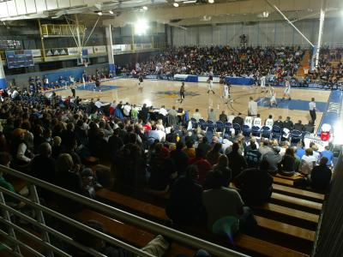
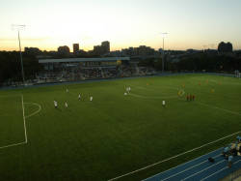
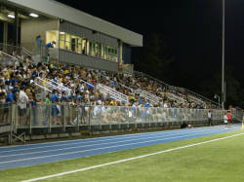
Athletic Improvements – Facilities Improvements
Stanley H. Durwood Soccer Stadium & Recreational Field
The DSSRF is the premiere soccer facility in The Summit League. The $9 million dollar was completed in 2009. DSSRF provides seating for 850 fans and a separate addition hosts locker rooms for men's and women's soccer, softball and track & field, as well as offices for the respective coaching staffs and concession areas.
Swinney Recreation Center
$500,000 in repairs and upgrades were made to Swinney Recreation in conjunction with both the men’s and women’s program moving back on-campus. The “Old Swinney” practice gymnasium was renovated and new spectator seating was purchased.

Slide 28
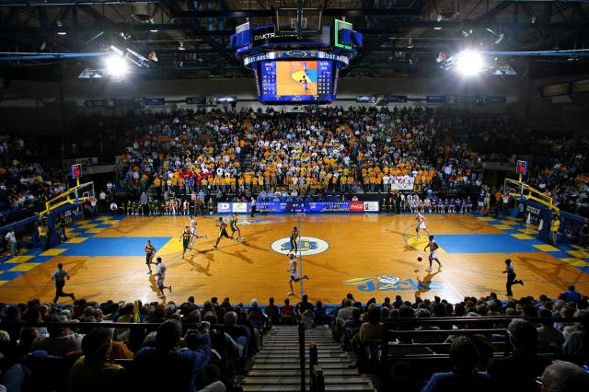
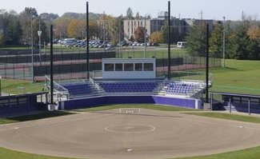
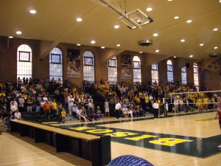
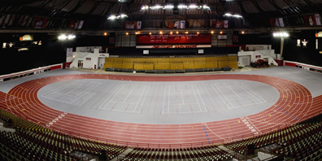
Athletic Improvements – Facility Benchmarking
Basketball Arena – SDSU Frost Arena
Volleyball Venue – NDSU Bentson Bunker
Softball Field – WIU McKee Softball Stadium
Indoor Track & Field – USD Dakota Dome

Slide 29
Athletic Improvements – Student Athlete Success
SA graduation rate of 64% is higher than institutional average of 46%.
UMKC’s student-athletes ended the 2010-11 academic year with a cumulative GPA of 3.22.
15 out of 16 teams finished the year with a cumulative GPA above 3.0.
136 student-athletes earned Summit League Academic All-League Honors for 2010-11.
53 student-athletes were named Summit League Distinguished Scholars for 2010-11.
76 student athletes were named to the Summit League Commissioner’s List of Academic Excellence

Slide 30
Athletic Improvements – Competitiveness

Slide 31
Athletic Improvements – Competitiveness

Slide 32
ATHLETIC BUDGET

Slide 33
Total Athletic Budget – Summit League
Summit League’s Total Athletic Budget Average is $9.6 million
UMKC is 21% above the Summit League Average, when $1.6 million overage is figured into the budget.
UMKC ranks 3 out of the 9 schools in the Summit League

Slide 34
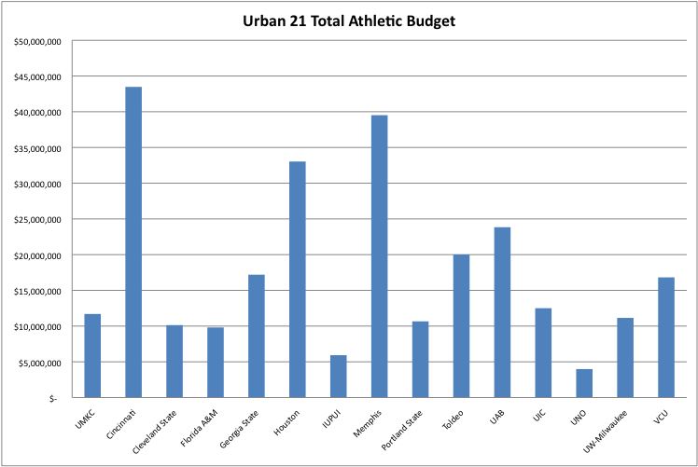
Total Athletic Budget – Urban 21
Urban 21’s total athletic budget average is $17 million.
UMKC is 35% below the Urban 21 average.
UMKC ranks 9 out of the 21 schools in the Urban 21.

Slide 35
Sports Operating Budget – Summit League
Summit League’s Sports Operating Budget Average is $1.7 million
UMKC is 23% below the Summit League Average
UMKC ranks 8th in the Summit League

Slide 36
SOURCES OF REVENUE

Slide 37
UMKC Athletic Budget– Sources of Funding
Institutional support exclusive of waivers has increased 71% in the past four years; Student fee revenue has incrementally increased over the same time frame.
External revenue for NCAA/conference; game guarantees and donations has increased. Ticket sales have decreased, but athletics saved $300,000 annually with the move from Municipal to Swinney.

Slide 38
Student Athletic Fees – Summit League
Summit League’s Student Fee Average % of total athletic revenue is 17% and $1.7 million annually.
UMKC is 33% below the Summit League average with $1.1 million in student support.
UMKC ranks 6th in the Summit League for student athletic fee support.

Slide 39
Student Athletic Fees – Urban 21
Urban 21’s Student Fee Average % of total athletic revenue is 40%.
UMKC is 80% below the Urban 21 average of $5.6 million.
UMKC ranks 14 out of the 21 schools in the Urban 21.

Slide 40
Student Athletic Fees – Peers/Enrollment
Seven peer institutions compared with similar enrollment as UMKC
UMKC student athlete fee revenue is 64% below the average of $3.1 million
UMKC student fee percentage in comparison to overall athletic budget is 61% below the average of 25.6%.
Average revenue per student is $210.59 annually, compared to $81.41 for UMKC.

Slide 41
Student Athletic Fees – Projections
Two scenarios (12 hour cap and no cap with four student fee allocations are presented for consideration.

Slide 42
Institutional Support – Summit League
Summit League’s Institutional Support Average % of Total Revenue is 50% and $5 million.
UMKC is 29% above the Summit League Average.
UMKC ranks 2nd out of the 9 schools in the Summit League.

Slide 43
Institutional Support – Urban 21
Urban 21’s Institutional Support Average % of total athletic revenue is 24%
UMKC is 75% above the Urban 21 Average of $4.1 million.
UMKC ranks 4th in the Urban 21.

Slide 44
Institutional Support – Peers/Enrollment
UMKC institutional support is 84% above the average of $3.9 million
UMKC institutional support percentage in comparison to overall athletic budget is 101% above the average of 31.9%.

Slide 45
External Support – Summit League
Summit League’s external support average percentage of total athletic revenue is 19%.
Average external revenue is $1.9 million in the SL with UMKC at $1.3 million.
UMKC ranks 4th out of the 9 schools in the Summit League

Slide 46
External Support – Urban 21
Urban 21’s external support average percentage of total athletic revenue is 27% and $6.2 million.
UMKC is 31% below the Urban 21 average
UMKC ranks 9 out of the 21 schools in the Urban 21

Slide 47
THANK YOU!

