Slide 1
Provost report, Faculty Senate
Feb 5, 2019

Slide 2
eLearning Taskforce
system-wide committee
17 members
All Provosts, various other system administrative officers
At least two Curators
One faculty rep from each campus
Biweekly meetings
Website: https://www.umsystem.edu/ums/aa/elearning
Consultants Ernst & Young-Parthenon: review current activities and develop path for future
system feels time is of essence to capture online student market
goal is new students, not conversion of current students to online
25K students in next 5 years “25,000 new learners by 2025”

Slide 3
members
Gary Allen, Vice President for Information Technology, UM System
Barb Bichelmeyer, Provost, UMKC
Mun Choi, President, UM System
Kelvin Erickson, Professor of Electrical and Computer Engineering, Missouri S&T
Dale Fitch, Associate Professor and Director, School of Social Work, MU
Steve Graham, Senior Associate Vice President for Academic Affairs, UM System
Christine Holt, Chief of Staff, UM System
Robert Marley, Provost, S&T
Carrie Nicholson, Research Consultant II and Project Manager, UM System
John Phillips, Curator, Board of Curators
Latha Ramchand, Provost, MU
Ryan Rapp, Vice President for Finance and Chief Financial Officer, UM System
Amber Reinhart, Faculty Fellow and Associate Chair of Communication, UMSL
Kristin Sobolik, Provost, UMSL
David Steelman, Curator, Board of Curators
Ajay Vinze, Dean of the College of Business, MU
Marilyn Yoder, Associate Professor and Division Head, School of Biological Sciences, UMKC

Slide 4
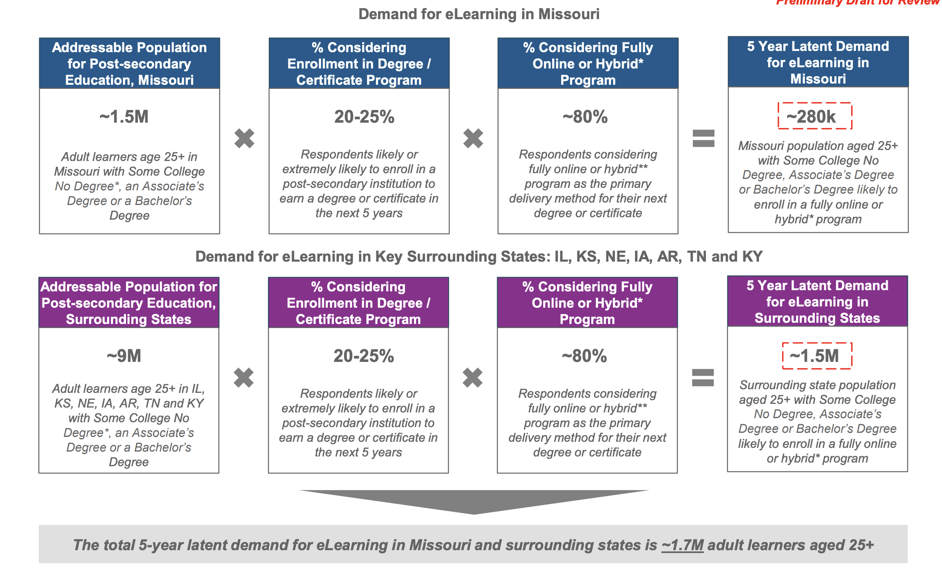
N = 539

Slide 5
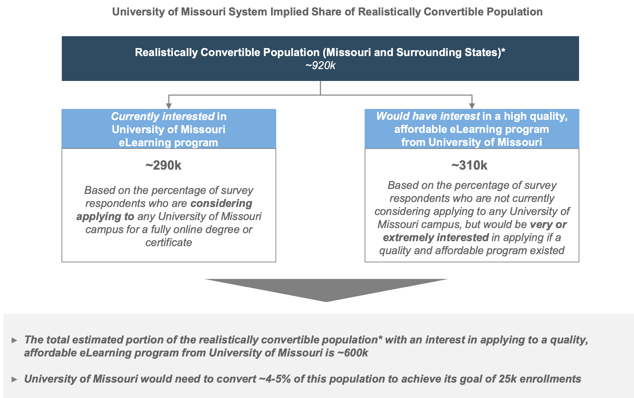

Slide 6
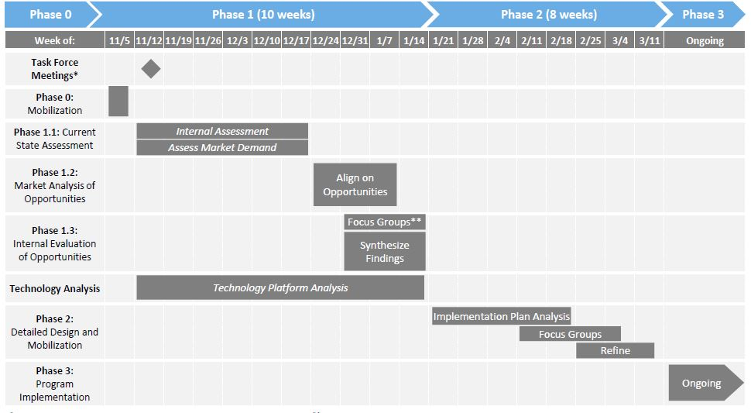
Taskforce process
Phases of Project:
Phase 1.1 –current state assessment
Phase 1.2 – market analysis of opportunities
Phase 1.3 – internal evaluation of opportunities
Phase 2 –design and mobilization
Phase 3 – Implementation Support (optional –decided solely by University)

Slide 7
Data sources
Internal assessment
One-on-one interviews (~40) individuals
Online survey faculty teaching online

Slide 8
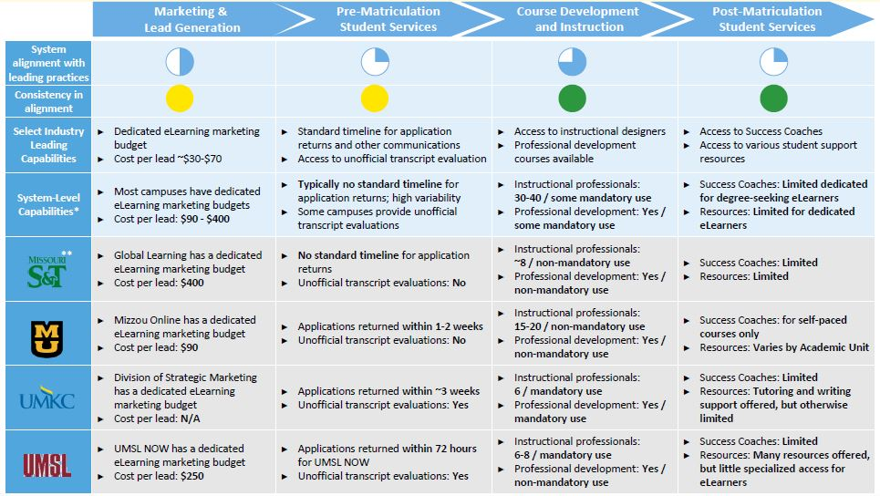

Slide 9
Entering phase 2
design and mobilization
considerations
“5th campus”, or campus focus
Where are degrees conferred: system or campus
Who owns courses/classes
Governance
Revenue stream and distribution
comparison to different institutions (ASU, Penn State World Campus, CO State Global, and Univ Nebraska)

Slide 10
Considerations on the table
internal build
partnering with ‘general contractor’ (a la carte purchase of specific services) or single partner for revenue share,
acquisition
Decision has not been made yet

Slide 11
Chief e-Learning Officer
new position
“responsible for developing, designing, building, and operating a nationally recognized online and digital-learning program serving adults and traditional students with fully-online degree programs and certificates”
ad placed
Search Committee is the eLearning Taskforce
have not begun review of candidates

