Slide 1
Office of Affirmative Action and Violence Prevention & Response annual & Mid-Year Reports and legislative & Regulatory Updates
Presented by: Sybil B. Wyatt, JD, MA, MS
Associate Director/Title IX Coordinator

Slide 2
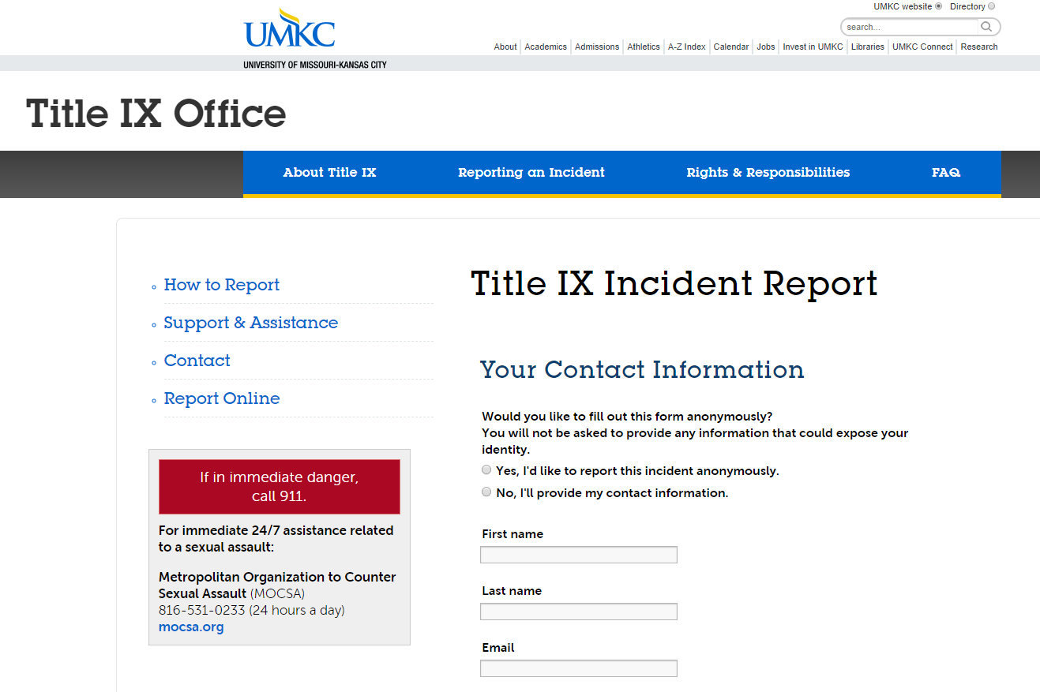
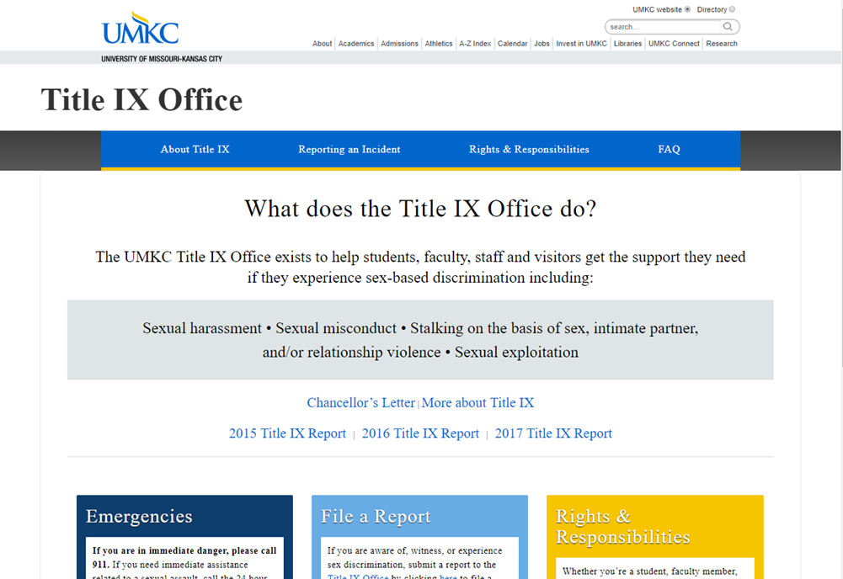
Office of Affirmative Action
Annual & Mid-Year Title IX Reports

Slide 3
Title IX Reports
Annual Report: August 1, 2017 - July 31, 2018
Mid-Year Report: August 1, 2018 - December 31, 2018
Includes reports of sex discrimination
Gender identity/expression
Pregnancy
Harassment/bullying on the basis of sex
Sexual misconduct
Stalking on the basis of sex
Dating/intimate partner violence
Full report available at https://info.umkc.edu/title9/

Slide 4
Title IX by the Numbers
Annual Report
121 jurisdictional reports
44 sexual harassment
31 sexual misconduct
13 dating/IP violence
9 sex discrimination
Gender identity/expression
Sexual orientation
0 false reporting
24 non-jurisdictional reports
Mid-Year Report
86 reports
32 sexual harassment
20 sexual misconduct
7 dating/IP violence
2 sex discrimination
Gender identity/expression
Sexual orientation
9 stalking
2 sexual exploitation
0 false reporting
41 non-jurisdictional reports

Slide 5
Title IX by the Numbers
Annual Report
Sexual misconduct reports
19 nonconsensual sexual intercourse
10 nonconsensual sexual contact
Location
12 on-campus
19 off-campus
Mid-Year Report
Sexual misconduct reports
16 nonconsensual sexual intercourse
3 nonconsensual sexual contact
1 exposure of genitals
Location
13 on-campus
7 off-campus

Slide 6
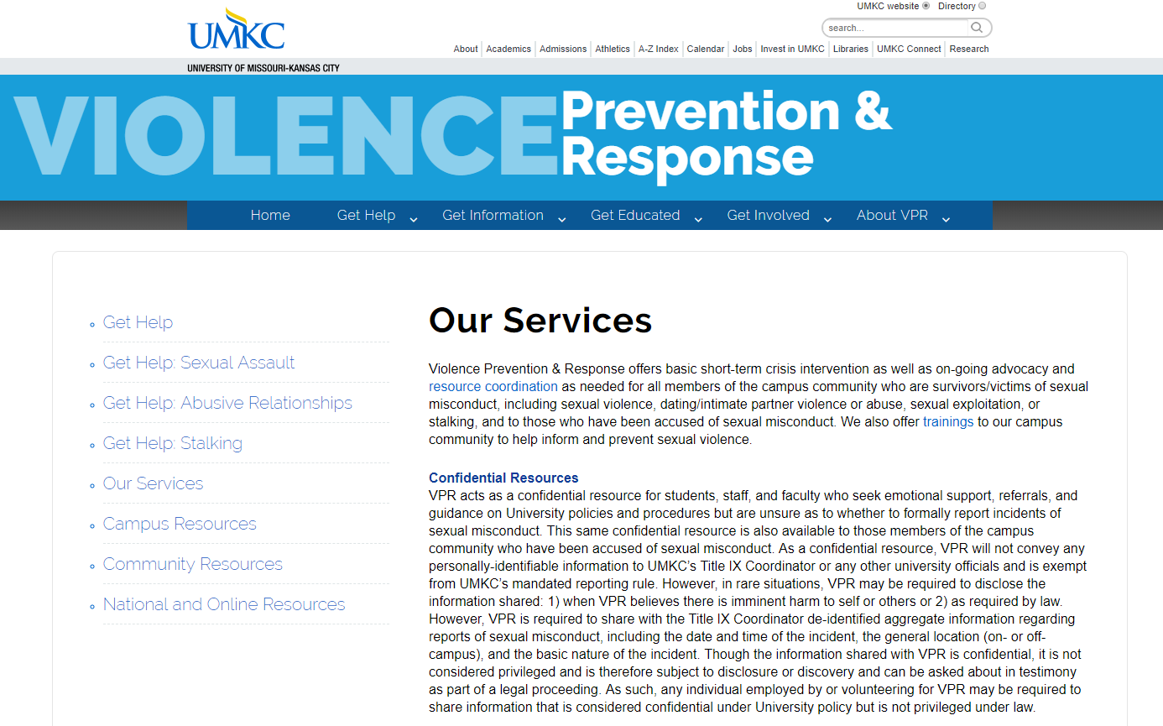
Violence Prevention & Response
Annual & Mid-Year Reports

Slide 7
VPR Reports
Annual Report: August 1, 2017 - July 31, 2018
Mid-Year Report: August 1, 2018 - December 31, 2018
Includes programming/outreach & crisis management
Orientations
Trainings
Tabling
Class presentations
Awareness events
Individual advocacy and consultations
More information: https://info.umkc.edu/vpr/

Slide 8
VPR by the Numbers
Annual Report
Direct Interactions
162 crisis management
5,496 in-person contacts
orientation
training
outreach
awareness programming
Indirect interactions
2,063 online training
Mid-Year Report
Direct Interactions
74 crisis management
10,091 in-person contacts
orientation
training
outreach
awareness programming
Indirect interactions
2,319 online training

Slide 9
Legislative/Regulatory Updates
Federal: Proposed Change to 34 CFR 106
State: House Bill 573/Senate Bill 259

Slide 10
Significant Changes
Federal: mandatory reporting
Only those “legally responsible to respond” or those with the ability to “remedy the situation” would have to report
Implications: Students may be less inclined to report directly to OAA, preventing the University from providing assistance or taking action
State: definition of consent
“The institution of higher education shall define consent as a freely given agreement to the conduct at issue by a competent person through words or overt actions.”
Implications: Disputed meaning of terms, does not address incapacitation or other aspects of consent

Slide 11
Significant Changes
State: due process hearing
Appeals allowed to external Administrative Hearing Commission
Implications: Expenses to UMKC including defense of process, civil action in court, possible fines of $250,000 if found in violation; chilling effect to reports as entire case would be heard by AHC
Federal/State: live hearing
Policy must provide live hearing (may require as only option without choice of administrative resolution)
Implications: Chilling effect as complaint dismissed if complainant refuses to attend or does not want to repeat allegations in front of faculty/staff panel

Slide 12
Significant Changes
Federal/State: direct cross-examination
Federal: Hearing must allow direct questioning of parties by each party’s advisor of choice (may be attorney) without technology to separate parties by request; if party will not submit to direct questioning, the decision-maker cannot consider any testimony provided by that party (even in Investigation Report)
State: Hearing must guarantee parties the right to cross-examine, either directly or indirectly
Implications: Chilling effect on complaints; inability to rely on prior testimony (federal); may be required to provide parties with legal counsel; process much more “court-like”

Slide 13
Significant Changes
Federal/State: standard of evidence
Federal: choice of preponderance or clear and convincing
State: clear and convincing
Implications: much higher threshold without ability to subpoena/require witness participation or submission of evidence
Federal/State: impartiality and bias
Federal: TIX coordinators, investigators, and decision-makers must be unbiased
State: investigators and decision-makers must certify no bias
Implications: may require anyone with exposure to sexual harassment/misconduct to disclose if involved in process

Slide 14
Questions?
Sybil Wyatt, Associate Director of Affirmative Action
Office of Affirmative Action
5115 Oak Street, Room 212
University of Missouri-Kansas City
Phone: (816) 235-6910
Fax: (816) 235-6537
wyattsb@umkc.edu
https://info.umkc.edu/title9/

