Slide 1
Enrollment Management Application Processing Update
Faculty Senate Meeting
September 18, 2018

Slide 2
Admissions & Recruitment Goals
From a student perspective, we will strive towards becoming more organized, seamless, and competitive. Admissions and recruitment initiatives, including visits, events, and communications, will flow centrally through the Office of Admissions.
With campus-wide planning and strategy, we will be more effective and broader-reaching in our recruitment and admissions efforts.
The alignment of campus-wide goals and metrics with unit/department-specific goals and metrics, will lead to a campus that is more unified, consistent in our branding and messaging, and collaborative.

Slide 3
Admissions & Recruitment Goals
4. We will align our goals and initiatives with our capacity and potential. In other words, we currently have not achieved our potential as an institution, and there are clear winners and losers within the units and departments of the university.
5. Rebuilding trust between campus partners, developing accountability goals, and identifying areas of collaboration are essential to our success.
6. SLATE will provide streamlined, consistent, and timely admissions processes and recruitment/communication efforts, and thus work towards notification of admission within 48 hours.
7. We will develop a strong, solid transition from recruitment through yield through retention.

Slide 4
Original Goals for Moving to Slate
Improved CRM for Communication to prospective students and throughout the application admittance process
Utilize Slate to notify students of missing applications materials
Retire EAS homegrown admissions applications
Make admissions decisions in Slate
Push out access to AU’s for earlier application information
Have one application tool for all applicants (e.g. Dual High School, Undergraduate, Graduate, Professional)

Slide 5
Using Slate in 2017-18
Rocky roll out in Fall 2017
Common App required to be live by August 1, 2017
Slate application was not thoroughly tested
Recruiters were not properly trained to use Slate
Applications were not being processed in a timely manner
Admissions staff were working out of three systems (Slate, PeopleSoft and Webnow)
Academic Units were called in to help with processing (test scores and core GPA) in February

Slide 6
Data Integration Issues
Integrations were not corrected until the end of July
Numerous meetings with EAS in the Spring where EAS stated they did not understand how Slate worked
Some examples:
Education Load – not bringing over all information to PeopleSoft
Transcripts were not loading from Slate to Webnow (including Parchment High School Transcripts)
Former Name was not loading from Slate to PeopleSoft
Test Scores were not loading from Slate to PeopleSoft
Preferred name was not loaded from Slate to PeopleSoft
Need to hard code data between Slate and PeopleSoft

Slide 7
Outstanding Slate Projects
Processing in Slate
Adding logic for canceled applications
Scheduling all jobs via Tidal (EAS) to Streamline Data Feeds
Correcting student checklist rules
Utilize Slate to create a pending report
Establishing a seat deposit for tracking acceptance of admitted students
Use Slate for High School Counselors
Develop a Recruitment Dashboard

Slide 8
Reorganizing for Admissions
Primary Slate Functional Lead resigned in early September and took a position at MCC
Reorganizing this position to an Associate Director of CRM so UMKC can find a viable candidate
Reviewing processing in Admissions to develop a streamlined approach for admissions decisions
Moved application inquiry calls over to the Welcome Center

Slide 9
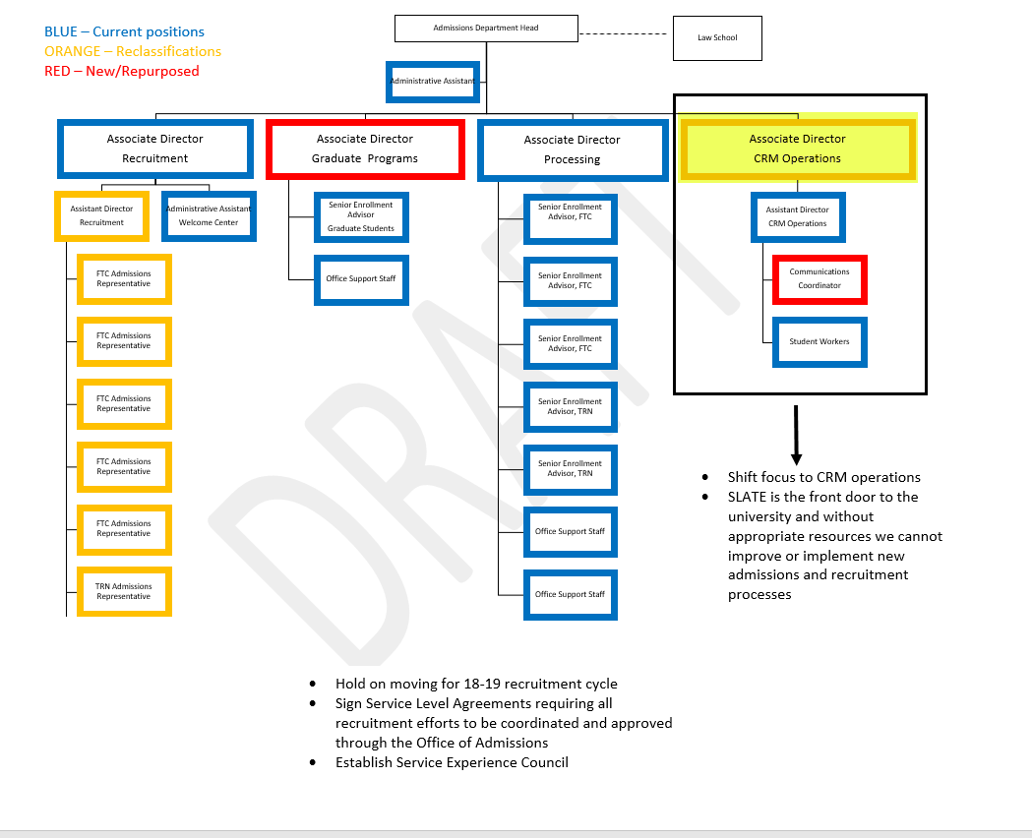
Reorganizing for Admissions

Slide 10
Establish Oversight Councils
Established Ad Hoc Faculty Senate Oversight Meetings with Jerry Wyckoff regarding Slate Issues
Strategic Enrollment Management Council
Recruitment Council
Retention Council
Become Data Informed and Strategic
AACRAO assist with development of SEM Plan
RNL assist with retention and recruitment efforts
New Scholarships just announced

Slide 11
Questions/Discussion

