Slide 1
Division of Student Affairs
Michele D. Smith, Ph.D.
Vice Provost for Student Affairs and Dean of Students

Slide 2
Org Chart

Slide 3
UMKC Student HelpLine
Referrals
Resources
Policy Questions
Complaints
Student Check-Ins
Emergency absences
Extended absences

Slide 4
Student Health & Wellness
Mission: to provide quality health care, health promotion, and education that maximizes the student learning potential.
Location: 5110 Oak Street (Brookside 51 Building), Suite 237
Phone: 816-235-6133
https://www.umkc.edu/studenthealth/

Slide 5
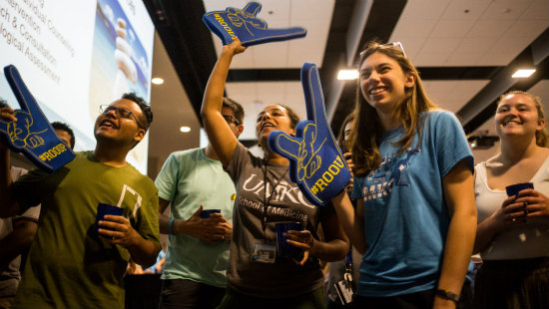
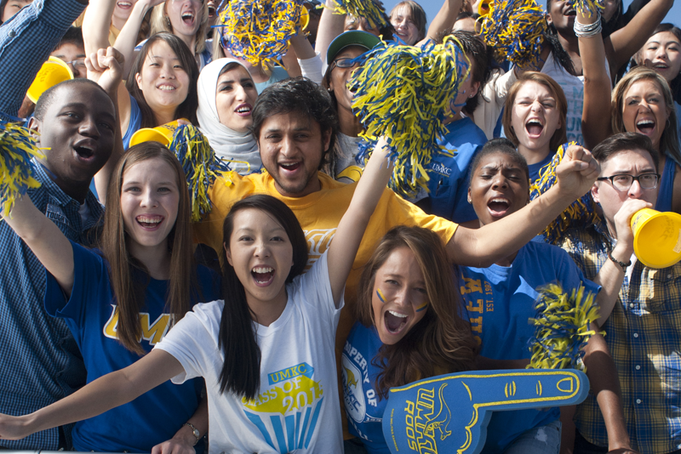
Office of Student Involvement
300+ Student Organizations
Fraternity & Sorority Affairs
Kangaroo Pantry
Basic Needs Coordinator
Leadership, Advocacy, & Service
LGBTQIA Programs & Services
Transfer Student Network
Union Programming Board (UPB)
UMKC Parent and Family Programs
Roo Welcome and New Student Programs
RooGroups

Slide 6
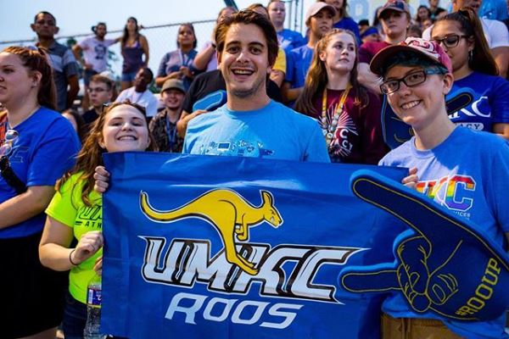
Campus Recreation
Student Membership – Included in Student Fee
Free Group Fitness Classes & Wellness Events
Free Intramural Leagues & Events
Free Aquatic Events
Free Bike Rental – Bike Share Program
Access to entire facility, including Aquatics Center, Durwood Recreational Field, and Swinney on The Hill
Personal Training, Bod Pod Assessments, and Swim Lessons
Student Employment Opportunities
Employ over 100 student employees
Apply on Handshake
https://campusrec.umkc.edu/
Follow us @umkcrec

Slide 7
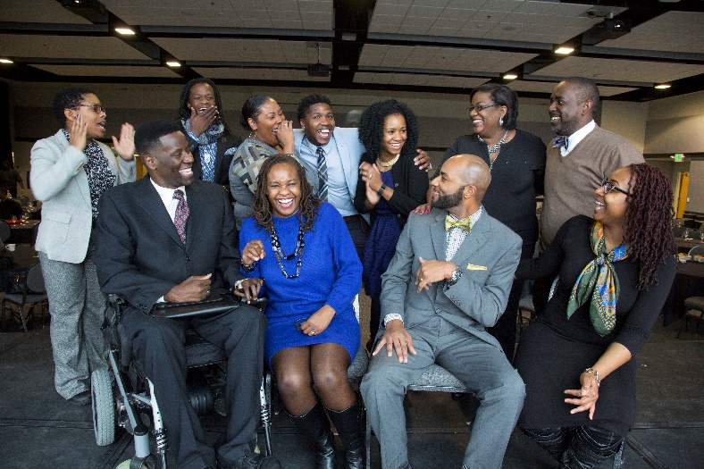
Multicultural Student Affairs
Mission: “Home Away from Home”
Scholar Programs
African Americans Cultivating Excellence (AACE) Mentoring Program
Avanzando Latinx Mentoring Program
Emerging Research Program
Men of Color Academy (MOCA)
Signature Programs
Show Me Success Workshops
Who Am I? Identity Discussions
Graduate Reception
Adelante and Legacy Student Leadership Summits
Student Organization Advising (11 Multicultural based organizations)
Small Group Diversity Workshops

Slide 8
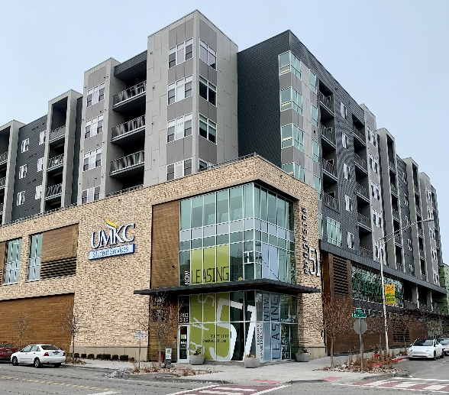
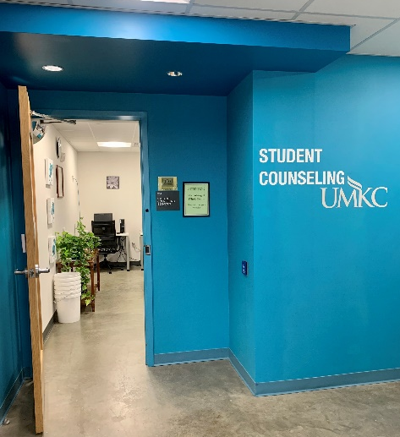
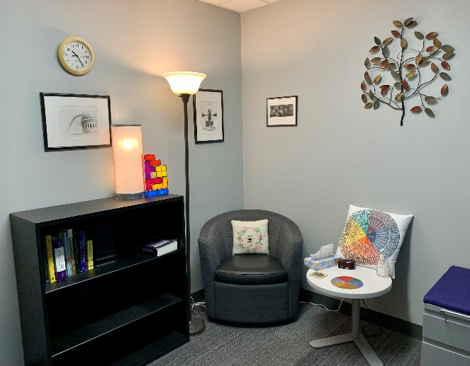
Counseling Services
Confidential
Crisis Intervention
Outreach
Group Sessions
Counseling Services
5110 Oak Street, Suite 201
KC, MO 64112
816.235.1635
www.umkc.edu/counselingcenter
Workshops
Consultation
Ask Listen Refer
MindBody Connection
Individual Therapy & More!

Slide 9
Student Disability Services
Students with disabilities are entitled to reasonable accommodations under state and federal law.
Please treat student’s disability information confidentially.
Letters of accommodation will be emailed to you detailing the required accommodations.
If you have concerns with any accommodation recommendation(s) contact me at laurentr@umkc.edu or (816) 235-5696
If a student with a disability is having academic difficulties, please contact me.

Slide 10
Student Veteran Support Services
ONE-STOP-SHOP
At Ease Zone (Student Union, Suite 310)
Resources, study, lounge
Education Benefits
GI Bill, Tuition Assistance, Other
Programming
SV Peer Mentoring Program, Operation Enrollment
Boots to Books (Faculty/Staff training)
Advocating
State & Federal Laws
Deployments
gormlyea@umkc.edu

Slide 11
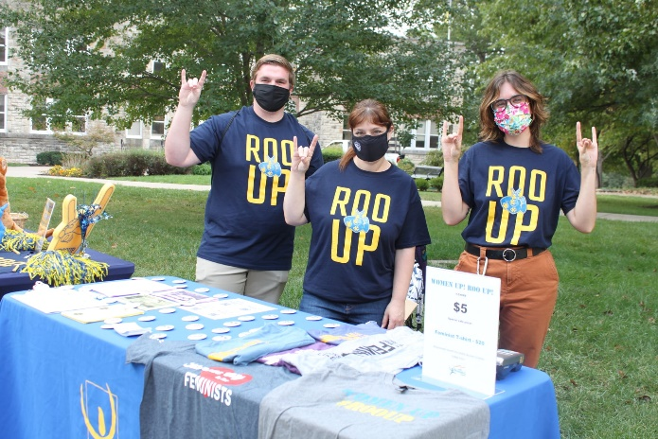
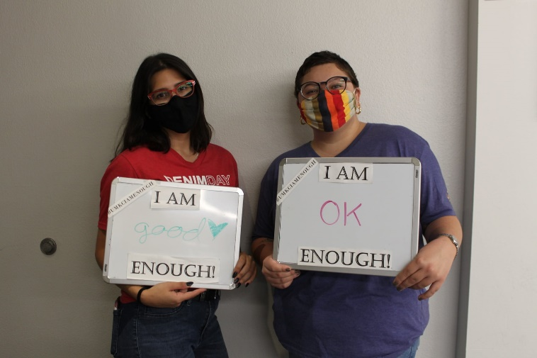
UMKC Women’s Center
Misson: To educate, advocate, and provide support services for the advancement of gender equity on campus and in the community at large
Programs/Services:
Internships
Event Space/Study Lounge/Conference Room
Information and Referral Services/Extensive Resource Library
Her Art Project
Roo Up! With the Women’s Center
Women Who Lead
Equal Pay Day
Body Image Programs
Healing Arts Workshops
Women’s History Month
Staff: Brenda Bethman, Director / Arzie Umali, Senior Assistant Director
Location: 105 Haag Hall

Slide 12
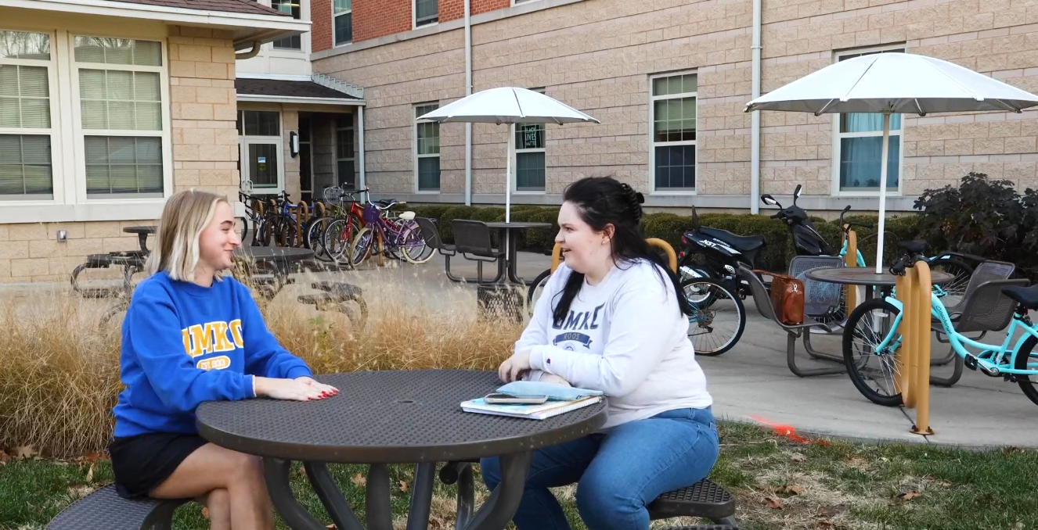
Residential Life
Four facilities – two residence halls, two apartment complexes with a capacity for 1,137 residents
24/7/365 operation (including through COVID-19)
10 full-time staff, 4 graduate assistants, and approximately 60 student staff
Student Leadership Experiences
Living Learning Communities Support Academics
Opportunity for Student Engagement with Faculty

Slide 13
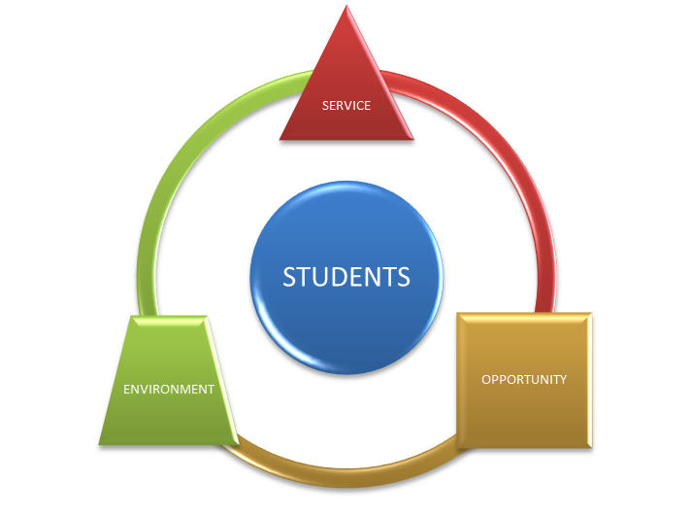
Student Union and Auxiliary Services
ENVIRONMENT
Traditional living room of campus
Vibrant, supportive climate
Accessible to all students and the campus community
SERVICE
Conference and Event Services
Residential and Retail Dining
Informal Recreation
ID Card Services
OPPORTUNITY
Informal and formal associations
Collaborative, engaging partnerships
Student Engagement
Student Employee Development
Event & Conference
Dining Services
ID Card
Bookstore
Information
Student Involvement
Multicultural
Student Affairs
Veteran Services
Academic Support
Student Union
Student Success Center

Slide 14
Campus Dining
Partnerships
Resident Dining
Chick Fil A, Einsteins, Starbucks
Local Partnership: The Roasterie
Catering/Athletic Concessions
Employee Discount Meal Plans
Creativity
Holiday Celebrations
Promotions & Sweepstakes
Guest Chefs and Rotating Concepts
New to Market Products
Collaboration
Student Culinary Council
Campus Intern Program
Student Life Activities
Sustainability Program
Innovation
Text Communication
Bite App / Order Ahead
Yokai Express (coming soon)
Prospect KC Partnership

Slide 15
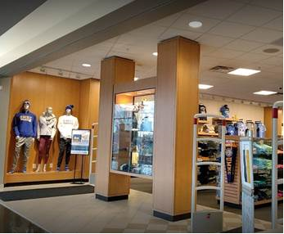
University Bookstores
UMKC Shop & Compare: Allows students to easily compare & purchase their materials from the vendor of their choice.
Early Bird Reservation Program: students sign-up prior to each semester and we pull their course materials for them.
AutoAccess: This academic year 359 UMKC courses were enrolled in the AutoAccess program, which saved students +$1.4 million dollars.
Technology: We offer academically discounted hardware and software that meets all University IT requirements.
Student Employees: We are one of the largest student employers on campus and offer a business management & leadership program to qualified students. Student employees also receive scholarships for course materials and other discounts.

Slide 16
Student Conduct & Civility
University of Missouri System Collected Rules & Regulations 200.010 & 200.020
Standard of Conduct & Rules of Procedures
Education, Investigation, and Adjudication
Rendered sanctions can range from a Warning to Expulsion
Conduct Code Violations vs. Criminal Violations
UMKC CARE Team (Campus Assessment Response & Education)
Interdisciplinary Team that works with students experiencing traumatic life experiences.

Slide 17
Blueprint for
Building a…
1. Impacting Student Success
2. Investing in a Talented Team
5. Engaging in the Responsible Use of Resources
S.T.A.R.R.
Division!
4. Strategizing to Build the Right Relationships
3. Building a Culture of Ambitious Assessment

Slide 18
Questions?
Answers
Wrap-Up

